Slide 1
‘CAMBA’
CORNEAL ANDHATVA MUKTA BHARAT ABHIYAN
(Corneal Blindness Free India Movement)
कॉर्नियल अंधत्वमुक्त भारत अभियान
SAKSHAMA
National Organization Dedicated for Specially abled people!!!
Notes:
This template can be used as a starter file for presenting training materials in a group setting.
Sections
Right-click on a slide to add sections. Sections can help to organize your slides or facilitate collaboration between multiple authors.
Notes
Use the Notes section for delivery notes or to provide additional details for the audience. View these notes in Presentation View during your presentation.
Keep in mind the font size (important for accessibility, visibility, videotaping, and online production)
Coordinated colors
Pay particular attention to the graphs, charts, and text boxes.
Consider that attendees will print in black and white or grayscale. Run a test print to make sure your colors work when printed in pure black and white and grayscale.
Graphics, tables, and graphs
Keep it simple: If possible, use consistent, non-distracting styles and colors.
Label all graphs and tables.

Slide 2
CAMBA – Vision & Mission
Vision:
Minimizing the burden of corneal blindness in the society with special focus on children and the adolescent group who will be the bright future of the nation
Mission:
Developing manpower, infrastructure, network and resources to minimize corneal blindness

Slide 3
Aims & Objective
To ascertain, by a survey, the actual number of persons affected by Corneal Opacity who require restoration of sight from Eye Donation
To diagnose the enlisted people for Corneal Opacity to analyze the possibility of relief through Eye Donation
To network with existing eye banks and to start eye collection centers
To network for seeking the support of Corneal surgeons, Ophthalmologists, Optometrists in the covered area.
To propagate the need of Eye Donation through intense awareness amongst public
To take efforts for improvement in the infrastructure for Eye Donation in the country

Slide 4
Why CAMBA?
No consistency in statistics related to prevalence of corneal opacity in INDIA
No consistency in Yearly estimates related to corneal opacity in INDIA.
No consistency in data related to Actual cornea collection in INDIA.
Inadequate infrastructure related to Eye Banking / Eye collection in INDIA

Slide 5
Inconsistency in Statistical Data!!
Year | Source | Prevalence | Yearly rise | Note
1986-1989 | NPCB (National Programme for Control of Blindness) and WHO (World Health Organization) study. Ref:- http://www.ncbi.nlm.nih.gov/pmc/articles/PMC3831688/ | 59 lakh | -- | Unilateral corneal blind
 |  | 19 lakh | -- | Bilateral corneal blind
1995 | Eye Bank Association of India | 45 lakh | -- | Corneal Opaque
2001 | Census Govt of India | 1.06 crore | -- | Blind (no details on corneal opacity)

Slide 6
Year | Source | Prevalence | Yearly rise | Note
2008 | The Director General of Health Services, MOH, GOI.(Ophth. Section) Ref: T-12011/10/2008 of 11th June 2008 | 20 lakh | 50000 | Corneal Opaque
2011 | Census Govt of India | 68 lakh | -- | Blind (no details on corneal opacity)
2013 | Indian Journal of Community Medicine (Ref: http://www.ncbi.nlm.nih.gov/pmc/articles/PMC3831688) | 68 lakh (Expected to rise to 1.06 crore by the year 2020) |  | Corneal Opaque

Slide 7
Year | Source | Prevalence | Yearly rise | Note
2014 | National Programme for Control of Blindness (NPCB) (Ref: http://www.ncbi.nlm.nih.gov/pmc/articles/PMC3831688/) | 1,20,000 (only one lakh twenty thousand) | 25000 to 30000 | Corneal Opacity
2015 | Eye Bank Association of India Ref : http://ebai.org/faqs.php | 11 lakh | -- | Corneal Opacity

Slide 8
Year | Source | Prevalence | Yearly rise | Note
2016 | Dr T P Lahane, Dean, ophthalmologist Grant medical college& Sir J.J. Group of Hospitals Mumbai India. (Email dtd 4 July 2016 to Dr Sukumar, Organizing Secretary SAKSHAM) | 12 lakh | -- | Corneal opacity
 | L V P Eye Institute, Hyderabad http://www.lvpei.org/pledge-your-eyes.php | 25 lakh | -- | Corneal opacity

Slide 9
Year | Source | Prevalence | Yearly rise | Note
 | Sankara Nethralaya, Chennai http://www.sankaranethralaya.org/eye-donation-faq.html | 46 lakh | -- | Corneal opacity
2015 | Narayana Nethralaya, Bangalore http://www.narayananethralaya.org/eye-bank/ | 7.1 % of blindness (i.e. 4.80 lakh) | 4 lakh required | Corneal opacity
 | Times Of India http://timesofindia.indiatimes.com/city/delhi/1k-eye-transplants-at-AIIMS-in-2014/articleshow/46510365.cms | 35 lakh | 30000 | Corneal opacity

Slide 10
Year | Source | Prevalence | Yearly rise | Note
2016 | Times Of India http://timesofindia.indiatimes.com/city/chandigarh/Corneal-blindness-accounts-for-25-of-total-1-5-crore-blinds-in-our-country/articleshow/15826978.cms | 25 % of 1.5 crore blind population of India (i.e. 37.5 lakh | Need 2 lakh per year | Corneal opacity
1995 | Eye Bank Association of India (Documentary – Audio Visual) | 11 lakh | 25000 | Corneal opacity

Slide 11
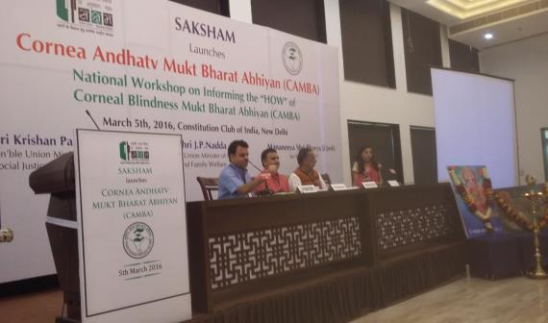
‘CAMBA’ LAUNCH -
National workshop on “CORNEA ANDHATWA MUKTA BHARAT ABHIYAN” Launched ON 05.03.2016 at Constitution Club, New Delhi
Inaugural session – Dignitaries on dais
Shri Krishna pal Ji Gurjar
Hon’ble Minister of State for Social Justice and Empowerment
Ms. Ira Singhal,
First disabled IAS topper.

Slide 12
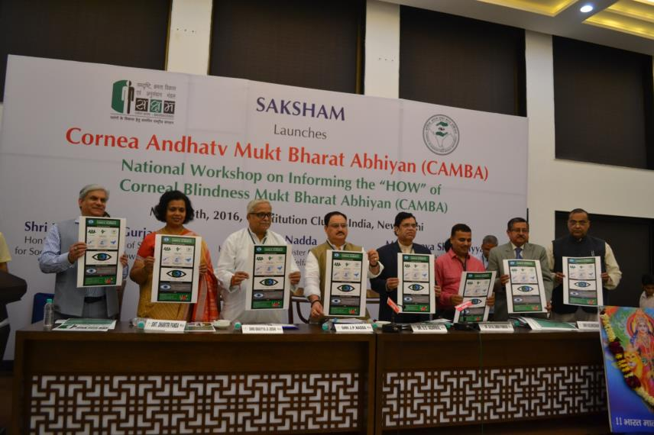
‘CAMBA’ LAUNCH -
Concluding session – Dignitaries on dais

Slide 13
‘CAMBA’ LAUNCH -
Concluding session - Dignitaries
Shri J P Nadda ji
Hon’ble Union Minister of Health
Shri Bhaiyaji Joshi
Mananiya Sarkaryavah of RSS
Dr. Radhika Tandon
EBAI National president
Dr. SS Agarwal
National President IMA
Mrs. Dharitri Panda,
Secy NBCS (National Blindness Control Society)

Slide 14
CAMBA DISTRICT SETUP

Slide 15
JS-1
SS-1
TS-1
TS-3
SS-2
TS-1
SS-3
SS-5
SS-4
TS-2
TS-2
TS-3
TS-1
TS-2
TS-3
TS-1
TS-2
TS-3
TS-1
TS-2
TS-3
JS-2
JS-1
JS = JILA SAMYOJAK
SS = SAHA SAMYOJAK
TS = TALUKA SAMYOJAK
MS = MANDAL SAMYOJAK
NR = NETRA RAKSHAK

Slide 16
JS
SS
SS
TS
TS
MS
MS
NR
NR
JS = JILA SAMYOJAK
SS = SAHA SAMYOJAK
TS = TALUKA SAMYOJAK
MS = MANDAL SAMYOJAK
NR = NETRA RAKSHAK

Slide 17
JS-2
SS-Store
SS-Transport
SS-Food
SS-Fund
JS = JILA SAMYOJAK
SS = SAHA SAMYOJAK
TS = TALUKA SAMYOJAK
MS = MANDAL SAMYOJAK
NR = NETRA RAKSHAK

Slide 18
CAMBA Working Procedure

Slide 19
To meet to inform and to seek support of - - Local MP, MLA, Mayor, etc. - Collector - CEO and Chairman of ZP - District Education Officer - Civil Surgeon - Dean of Govt Hospital and other big hospitals
Working procedure…

Slide 20
Working procedure…
Meeting with Doctors of Rural Hospitals to get the information about patients and to seek support in diagnosis, treatment and post operative care
Meeting with Head Masters and teachers of various school administration to seek their help

Slide 21
Meeting with - Sarpanch of the village. - Anganwadi - Asha workers - Gramsevaks to seek their support.
Working procedure…

Slide 22
We shall take the help of – - NGOs, - NSS units of various colleges. - Students of BSW and MSW. - Students of optometry, ophthalmic technician courses for survey and screening camps.
Working procedure…

Slide 23
Working procedure…
“NETRA RAKSHAK” (SIGHT KEEPER)
To connect the registered patient with the corneal surgeon, eye bank to facilitate keratoplasty and post operative follow up
To bring awareness amongst people to prevent corneal blindness.

Slide 24
“Saksham bharat,
Samarth bharat !”
SAKSHAMA-KARNATAKA
National Organization Dedicated for Specially abled people!!!
NO 55, Link Road, Sheshadripuram
Bengaluru - 560020
ON WEB: www.sakshamakarnataka.org
www.sakshamseva.org
Facebook - @SAKSHAMA KARNATAKA
E-MAIL: sakshama.karnataka@gmail.com
MOBILE: 9986699710

