Slide 1
Corneal Blindness
&
Eye Donation Awareness
SAKSHAMA
National Organization Dedicated for Specially abled people!!!
Notes:
This template can be used as a starter file for presenting training materials in a group setting.
Sections
Right-click on a slide to add sections. Sections can help to organize your slides or facilitate collaboration between multiple authors.
Notes
Use the Notes section for delivery notes or to provide additional details for the audience. View these notes in Presentation View during your presentation.
Keep in mind the font size (important for accessibility, visibility, videotaping, and online production)
Coordinated colors
Pay particular attention to the graphs, charts, and text boxes.
Consider that attendees will print in black and white or grayscale. Run a test print to make sure your colors work when printed in pure black and white and grayscale.
Graphics, tables, and graphs
Keep it simple: If possible, use consistent, non-distracting styles and colors.
Label all graphs and tables.

Slide 2
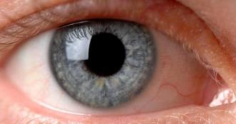
What is Eye Donation
Eye donation is a noble act of kith and kin OR family members of diseased, where they donate eye with intention to give sight to a corneal blind person
What is Cornea and Corneal Blindness?
The cornea is the clear tissue covering the front of the eye. It is a focusing element of the eye. Vision will be dramatically reduced or lost if the cornea becomes cloudy/damaged causing corneal blindness

Slide 3
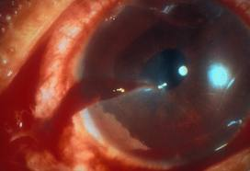
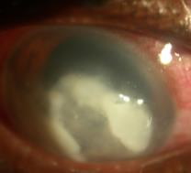
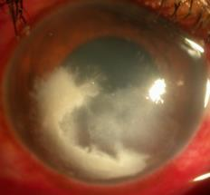
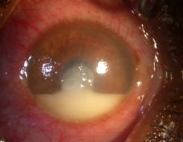
Main causes of Corneal Blindness
Injuries
Malnutrition
Infections
Chemical burns
Congenital disorders
Post operative complications or infections

Slide 4
Facts and Myths on Eye Donation
Myth - Eyes can be donated even by a live person.
Fact - Eyes can only be pledged by a live person. Eyes can be donated only after death.
Myth - Removal of eyes causes disfigurement of the face.
Fact - Removal of eyes does not produce any disfigurement of the face.

Slide 5
Myth - Eye donation interferes with, or delays customary final rites.
Fact - Eye donation does not interfere with or delay final rites, as the corneal excision procedure takes less than 20 minutes.
Myth - Eyes of aged donors are not acceptable.
Fact - All donor eyes are acceptable irrespective of the donor’s age, including eyes of premature/
still-born babies.

Slide 6
Myth - Indian eyes are not good to be used for corneal transplantation.
Fact - Eyes of any deceased person anywhere in the world can be used for corneal transplantation
following evaluation.
Myth - An entire eye can be transplanted.
Fact - Only the cornea is used for transplantation.
Myth - Corneal transplantation is an experimental procedure.
Fact - Corneal transplantation is a proven, routinely performed surgery and is a successful
procedure.

Slide 7
Myth - Human eyes can be bought or sold.
Fact - Selling or buying of human eyes is illegal
Myth - Only those who have pledged their eyes can donate them after death.
Fact - Pledging of eyes is not important, because even in the case of a pledgee, the consent of the family member is essential, without which an eye cannot be removed.

Slide 8
Few More Facts on Eye Donation
Eyes must be removed within 4-6 hours after death
The eye bank team may remove eyes at home of the deceased or at a hospital
Only the transparent section of the eyes called cornea is taken out and not the full eye ball
The identities of both the donor and the recipient remain confidential
One pair of eyes gives vision to TWO corneal blind people
A small quantity of blood will be drawn to rule out communicable diseases
Eyes donated to The Eye-Bank that are not medically suitable for transplant may be used for medical research and education

Slide 9
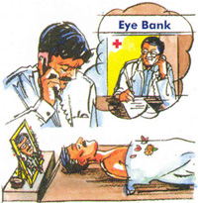
At the Time Death?
Close the eye lids of the deceased person
Keep cold water cloth or ice cubes on the eye lids to prevent drying out of the cornea
Switch off the fan (if running)
A couple of antibiotic eye drops are preferable to prevent any kind of infection to cornea - optional

Slide 10
When eye donation not possible?
When death is due to
Active viral Hepatitis
Acquired immunodeficiency syndrome (AIDS) of HIV
Active viral encephalitis or encephalitis of unknown origin
Creutzfeldt-Jakob disease
Rabies.
Death of unknown cause / Suspicious death

Slide 11
Important Eye banks in Bengaluru!
Sankara Eye Hospital- 080-28542727/28/29
Prabha Eye Clinic - 080-26637041
Minto Eye Hospital - 080-26707176
B.W. Lions Super Specialty Eye Hospital - 080-22235005/974055666
Narayana Nethralaya RajajiNagar- 080-66121300/1305/1400/1404
Narayana Healthcity - 080-66660655/0658
Shraddha Eye Bank - 080-26634200/9845195898
Ramaiah Memorial Eye Bank- 080-23608888

Slide 12
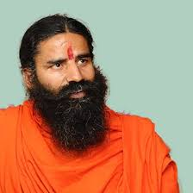
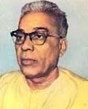
Prominent Eye Pledgees & Donors
BABA RAMDEV
Late Shri Balasaheb Deoras, Ex-Sar Sanghachalak of RSS

Slide 13
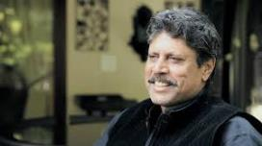
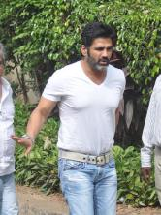
KAPIL DEV
AMIR KHAN
ANIL KUMBLE
RANI MUKHRJI
SUNIL SHETTI
PRIYANKA CHOPRA

Slide 14
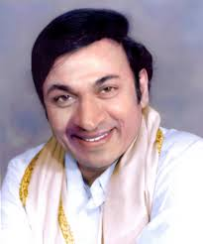
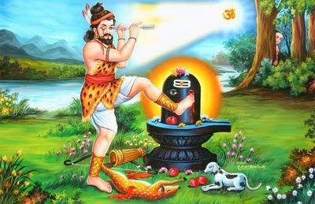
Veteran Kannada film actor Dr. Rajkumar donated his eyes
Bedara Kannappa, a devotee of Shiva is the first eye donor of world!!!

Slide 15
Srilanka & Eye Donation
Inspired & motivated by the success story of neighboring tiny nation Srilanka where no single case of cornea impairment has been found
It has declared the eye as national property & export cornea to several European & American countries that too free of cost
If it is possible for Srilanka, is it not possible for India?
If your answer is yes, then pledge your eyes today & be a part of SAKSHAMA's nation-wide campaign to declare eye as national property & in making an eye donation as national tradition.

Slide 16
A National Solution - CAMBA !!!
CAMBA” stands for Corneal Andhatva Mukta Bharat Abhiyan, means Corneal Blindness Free Bharat Movement
Objective of CAMBA is,
To ascertain, by a survey, the actual number of persons affected by Corneal Opacity who require restoration of sight from Eye Donation
To diagnose the enlisted people for Corneal Opacity to analyze the possibility of relief through Eye Donation
To network with existing eye banks and to start eye collection centers
To network for seeking the support of Corneal surgeons, Ophthalmologists, Optometrists in the covered area.
To propagate the need of Eye Donation through intense awareness amongst public
To take efforts for improvement in the infrastructure for Eye Donation in the country

Slide 17
Donate Eyes
Give sight!!
SAKSHAMA-KARNATAKA SOUTH CHAPTER
National Organization Dedicated for Specially abled people!!!
NO 55, Link Road, Sheshadripuram
Bengaluru - 560020
ON WEB: www.sakshamakarnataka.org
www.sakshamseva.org
Facebook - @SAKSHAMA KARNATAKA
E-MAIL: sakshama.karnataka@gmail.com
MOBILE: 9986699710

